Slide 1
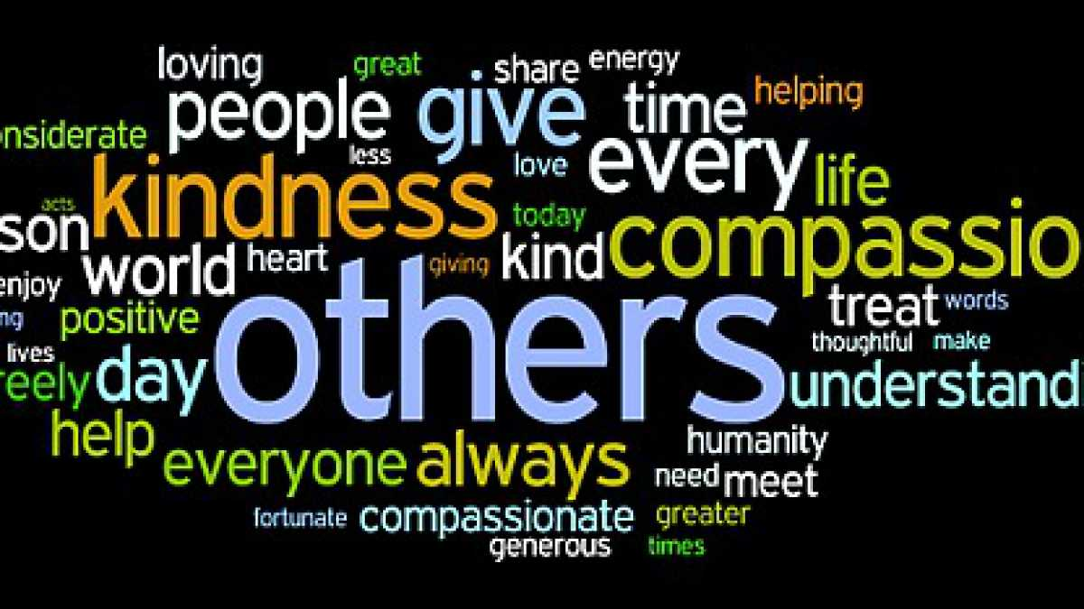
Tzu chi English Educational
Speaking
Being able to express your opinion
Listening
Active Listening with understanding
Creativity
Adding new thoughts to the discussion
Questions
Team Building
Asking poignant questions
Skills Fostered in this Class
Why aren’t we more compassionate?
Level 4 of 6
Questions
Believe
Assume
Investigate
Separate
Create a word bank for discussion
Compassion
Noticing
An example for others
Emotional Empathy
Why do we help sometimes and don’t at other times?
Do our compassionate actions influence those around us?
Christopher Bauman – www.chrisbauman.com.au

Slide 2
1. All of us have so many opportunities to help
____________________________________________________________________________________________?
Advanced Question Words
2. Our focus is in the wrong direction. ___________________________________________________________________________________________ ?
Compassionate purchases
Compassion
3. Our default wiring is to help ___________________________________________________________________________________________ ?
Distraction
A moment
Time
4. Feeling good for the people who are being helped. ___________________________________________________________________________________________ ?
Optimistic
You
Emotional Empathy
5. Pay full attention to the person. ___________________________________________________________________________________________ ?
In a hurry
6. We become victims of a system that points us elsewhere ___________________________________________________________________________________________ ?
Compassionate choice
Wrong direction
7. When we pass a someone in need it stays on the periphery of our vision ___________________________________________________________________________________________ ?
Do we turn part of ourselves off?
8. The moment I stopped half a dozen other people immediately stopped to help as well ___________________________________________________________________________________________ ?
Kindness
Sometimes it is just the simple act of noticing
Christopher Bauman – www.chrisbauman.com.au

